Slide 1
Module 1 Part2
12/05/2022

Slide 2
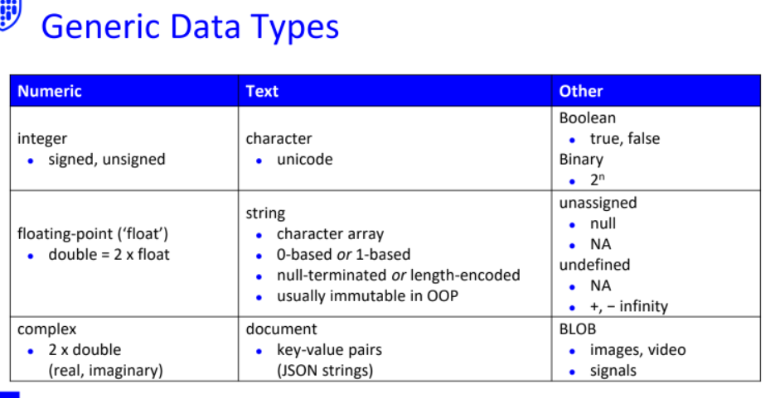

Slide 3
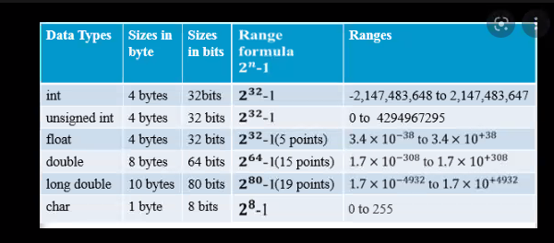
Double uses 8 bytes,but float only used 4 bytes, spend more memory. Double have wider range than float

Slide 4
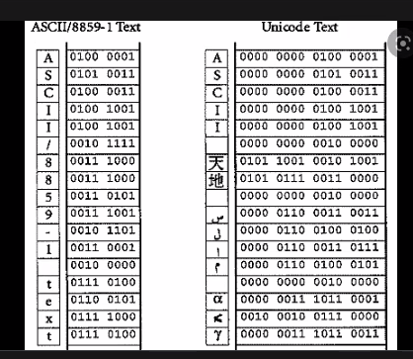
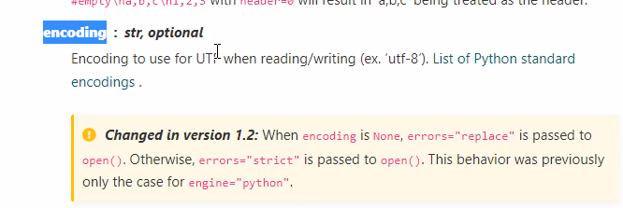
Word documents store inUTF-8
Old document stored in BOCU
Based on this, you need to tell the function
Default is UTF

Slide 5
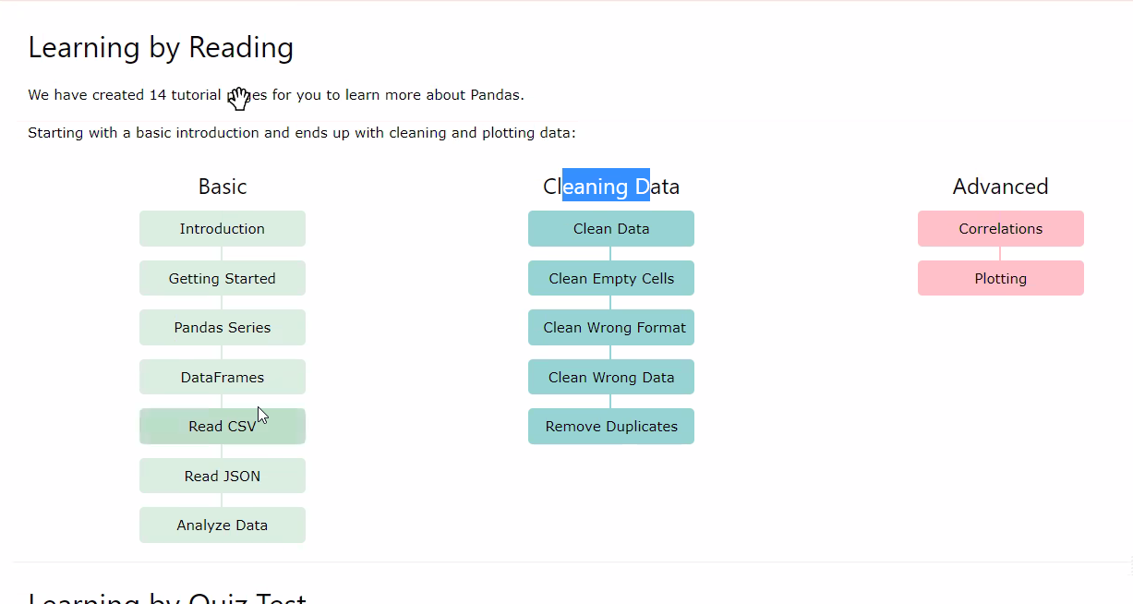
Like if we have empty data, what we do with them

Slide 6
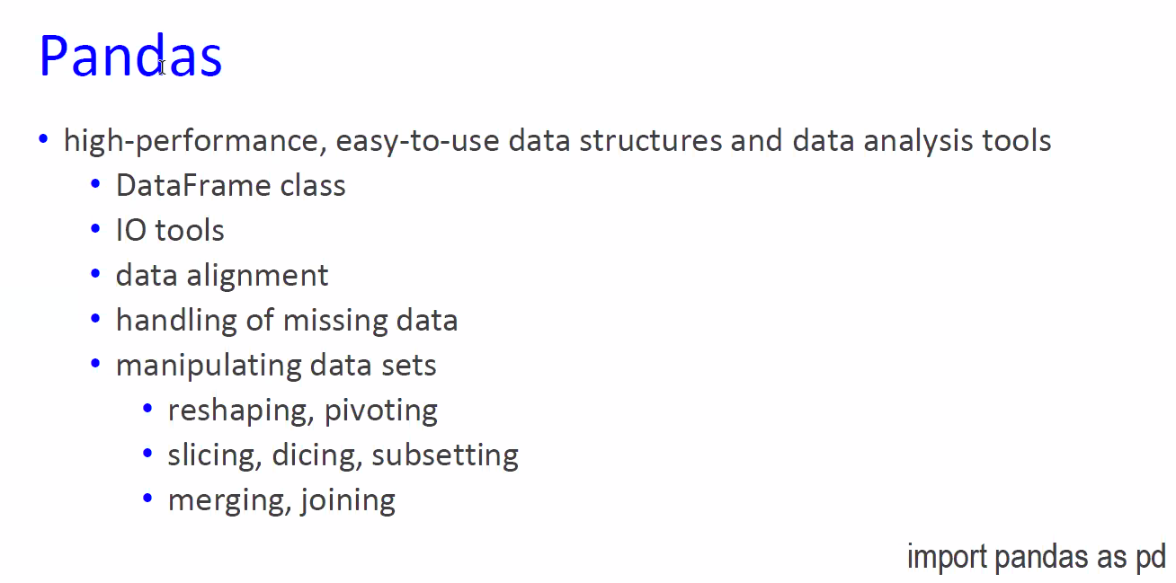

Slide 7
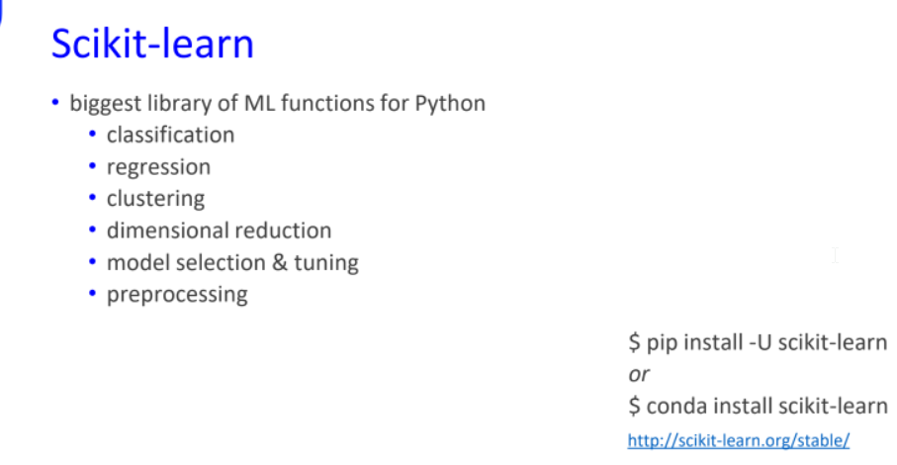
Best library to do machine learning
Pip may not install all
We better install everything with Conda
Conda install everything, will take longer

Slide 8
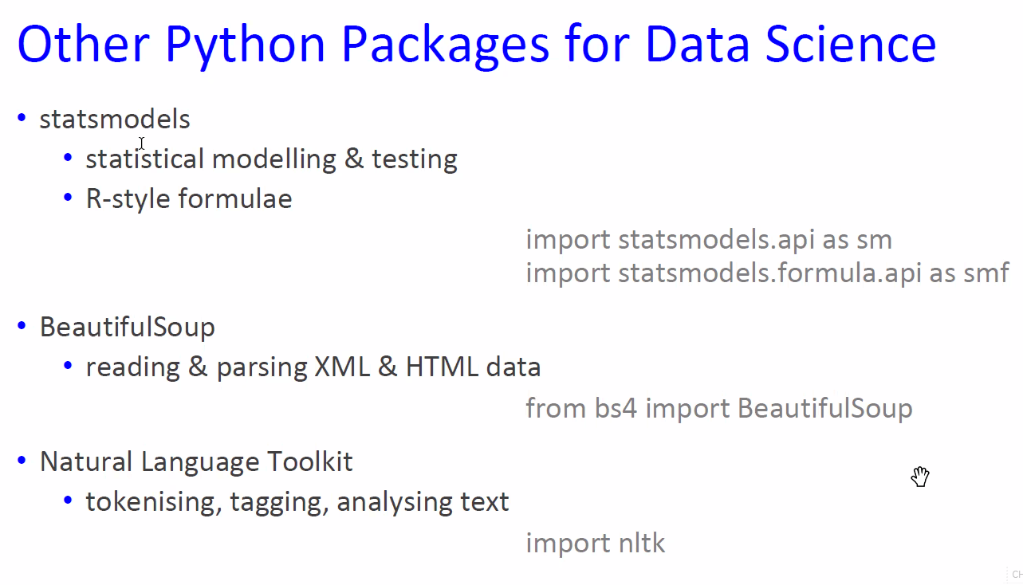
Scraping, API
Module 9

Slide 9
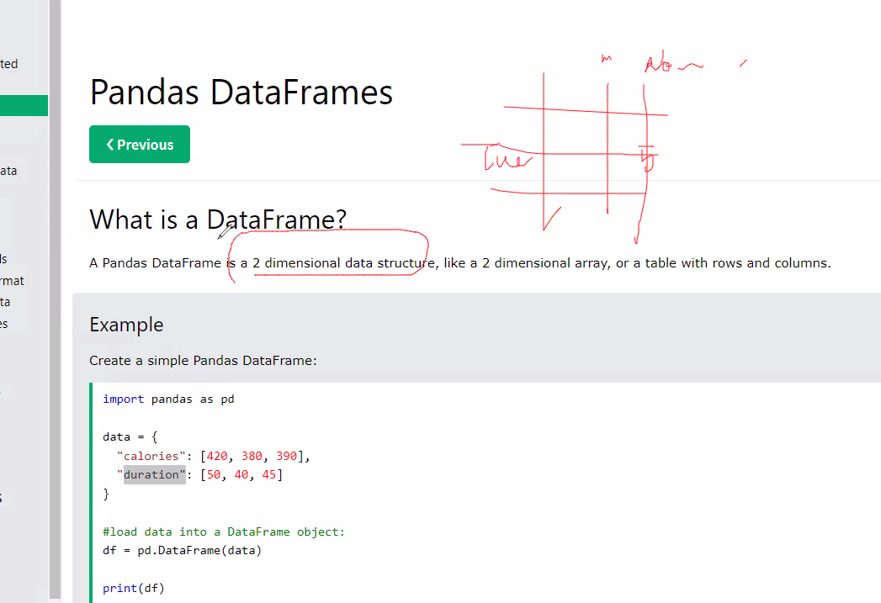
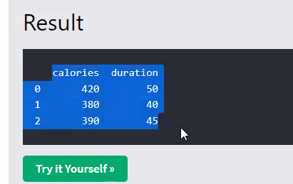
Columns equal features, if we say we have 2 columns, we say we have 2 features
Dictionary,means we have two values
convert dictionary to dataframe

Slide 10
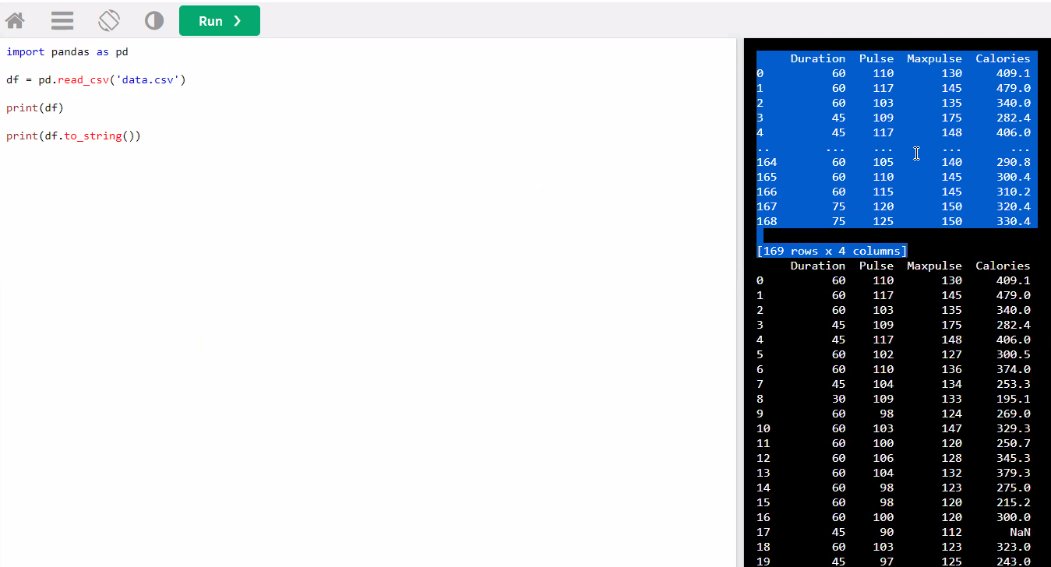

Change to string Print all for me
Show 2 head lines

Slide 11
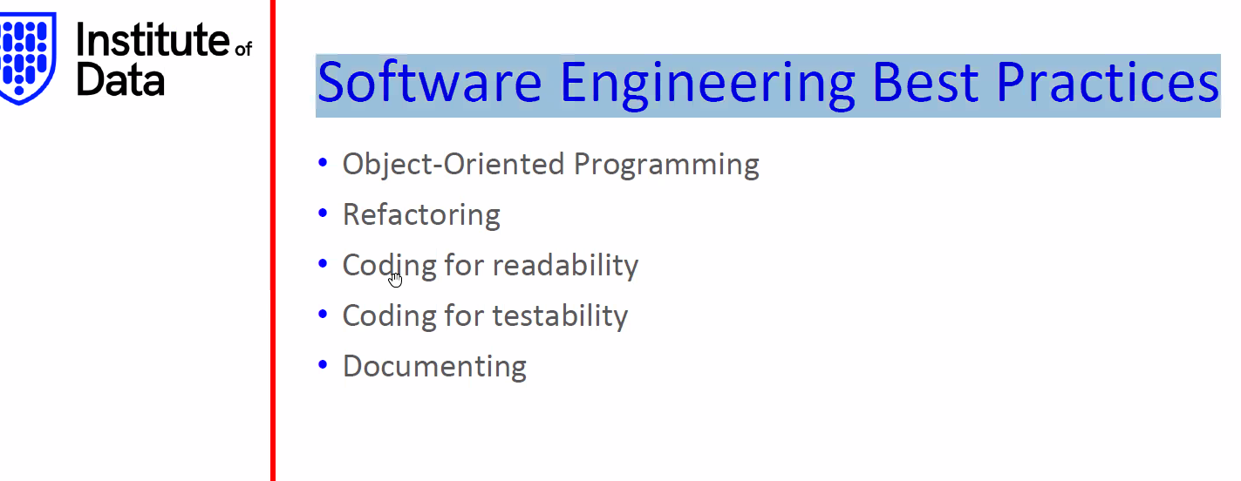
First two are really advanced

Slide 12
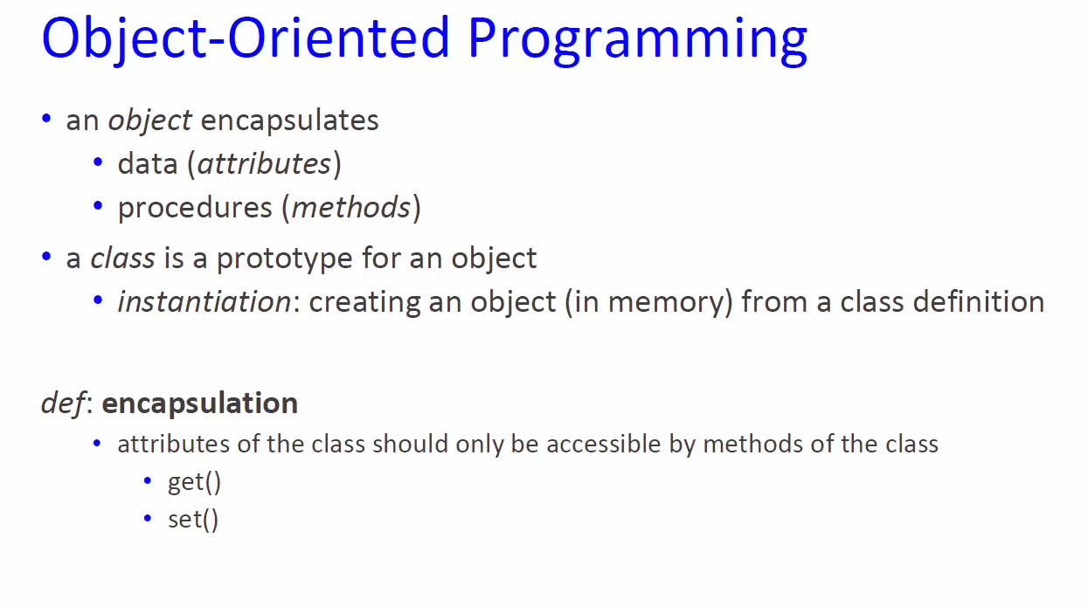
Use object be running quicker

Slide 13
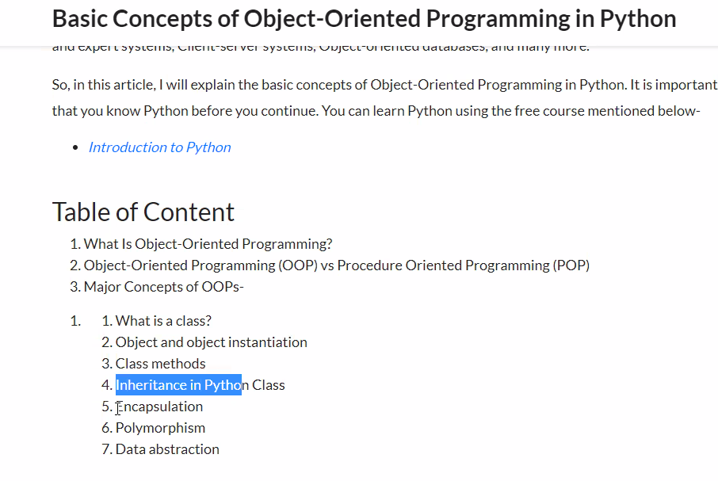
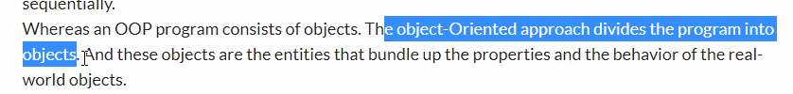

Slide 14
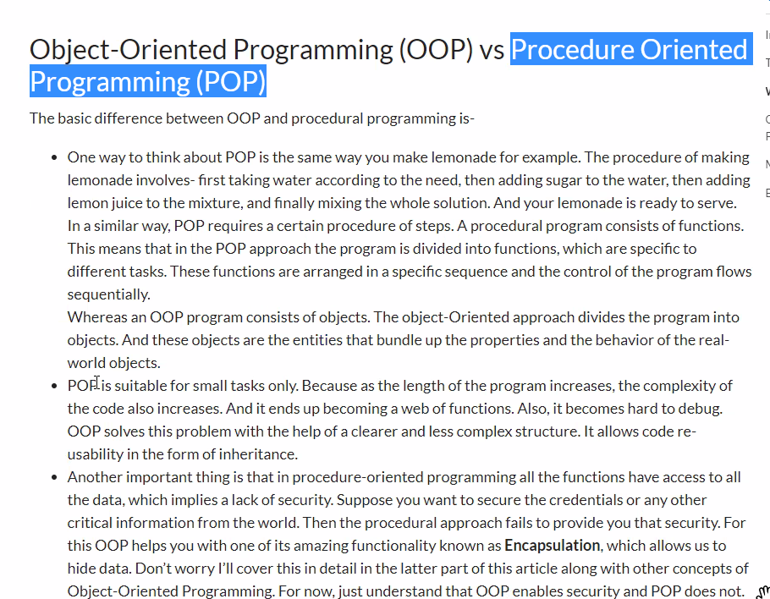
If we have big task, better to use OOP
Security reason

Slide 15
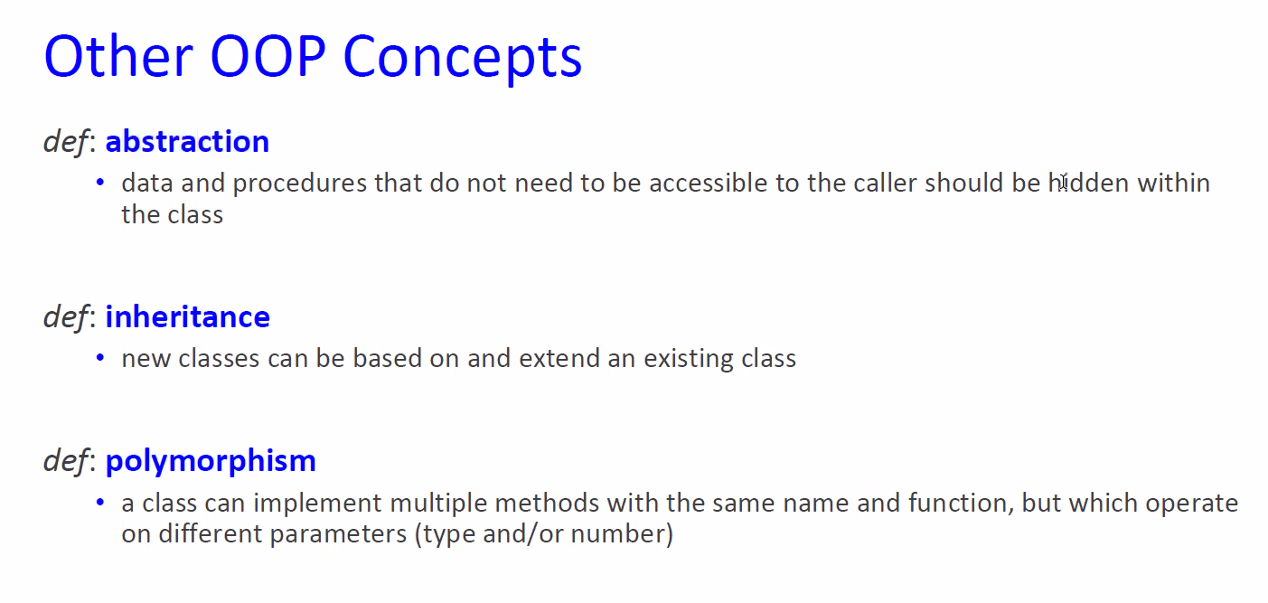

Slide 16
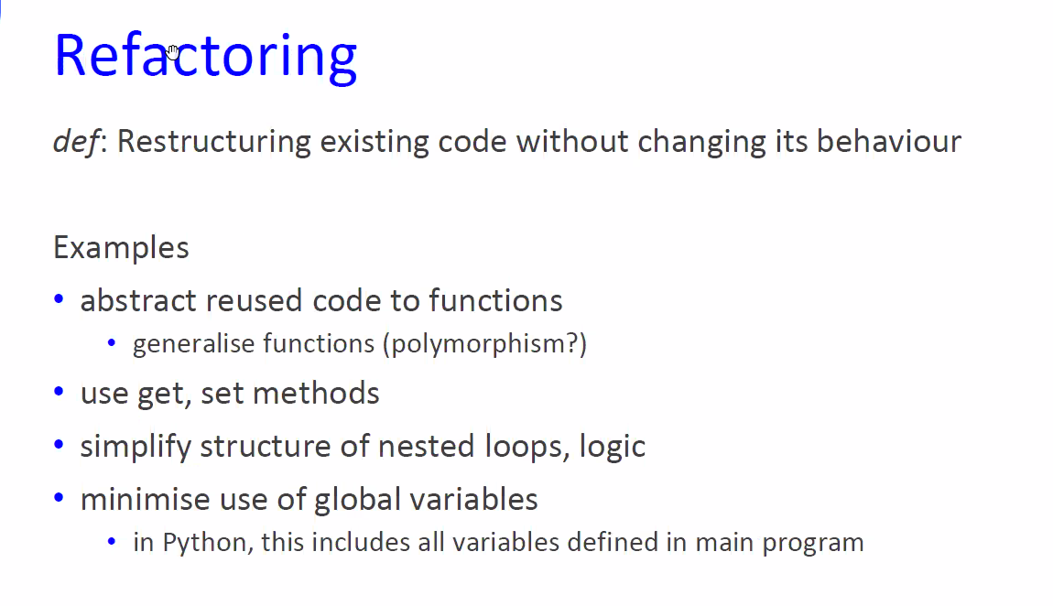

May change the class, change the function

Slide 17
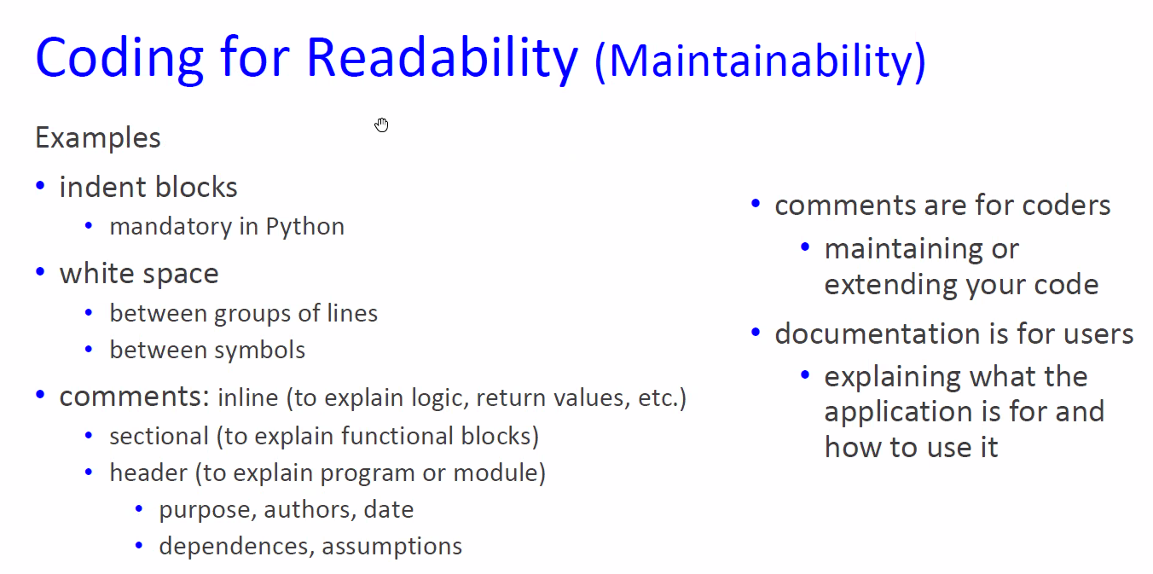

Use jupyter to present, to comments, if you leave the company,other person can figure out easily

Slide 18
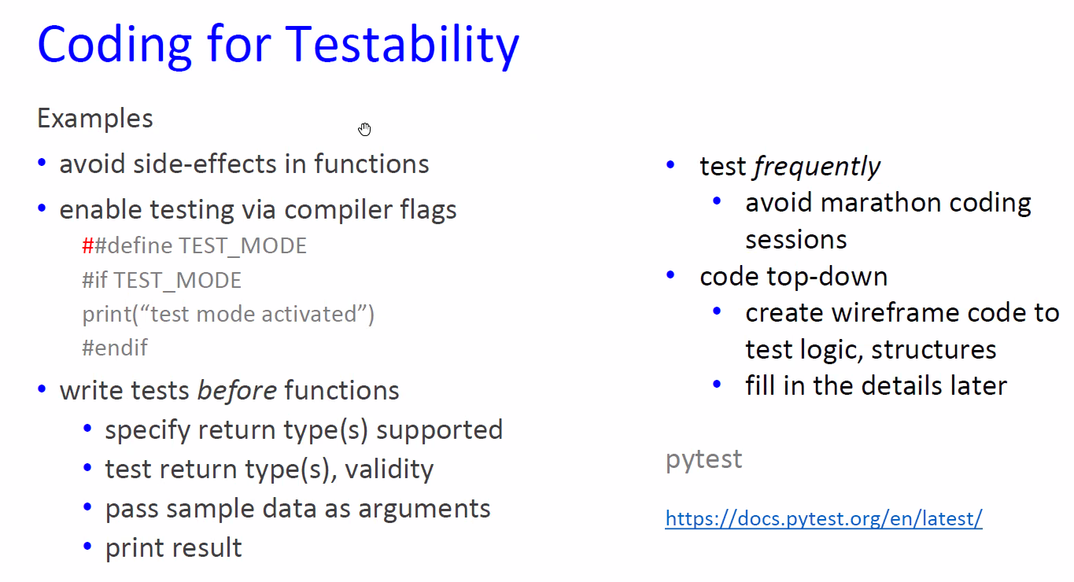
Make sure other people can use your

Slide 19
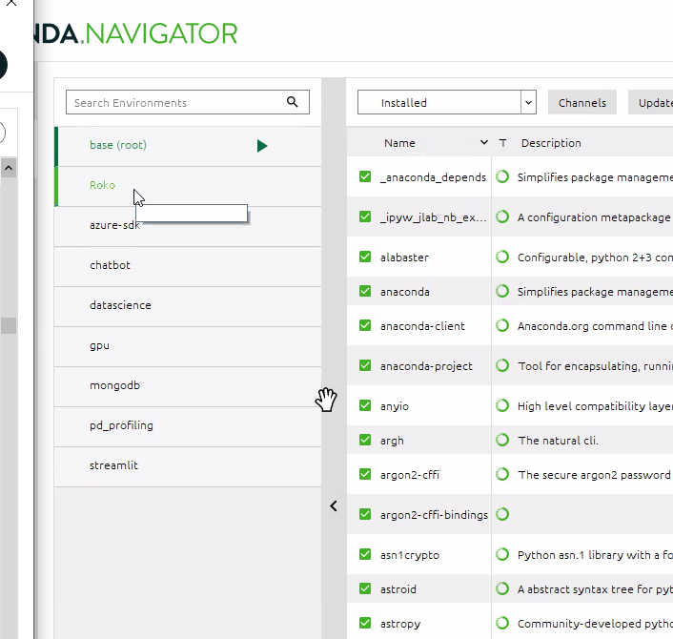

Slide 20

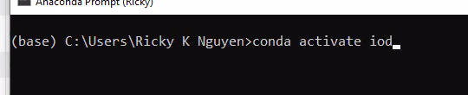
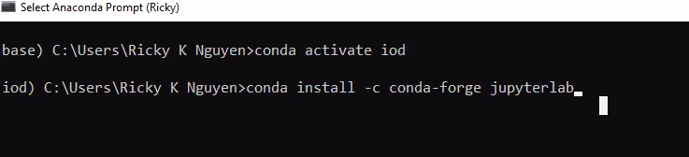
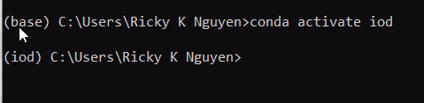
Terminal is powerful
The base is on the Condona navigator, we never use “Base”, we need to go to the IOD environment

Slide 21
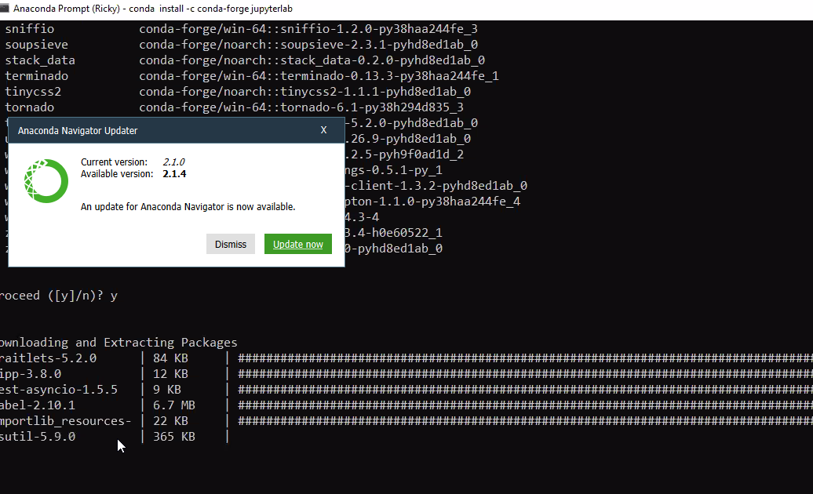

Slide 22
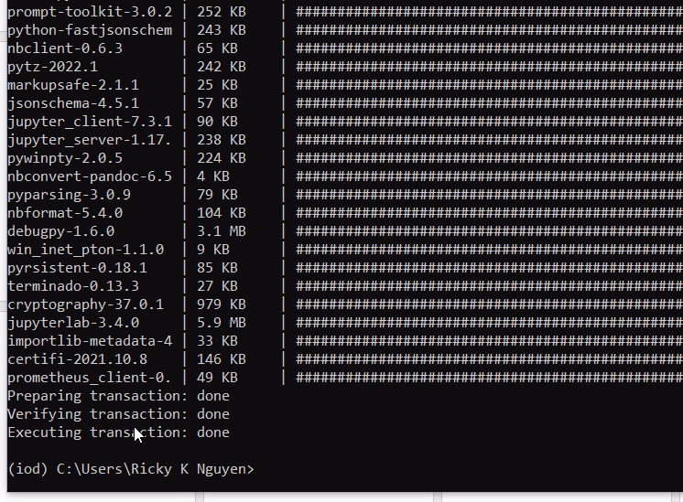

Slide 23
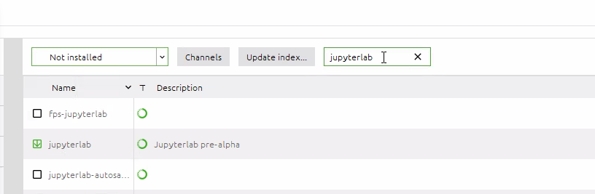

Slide 24
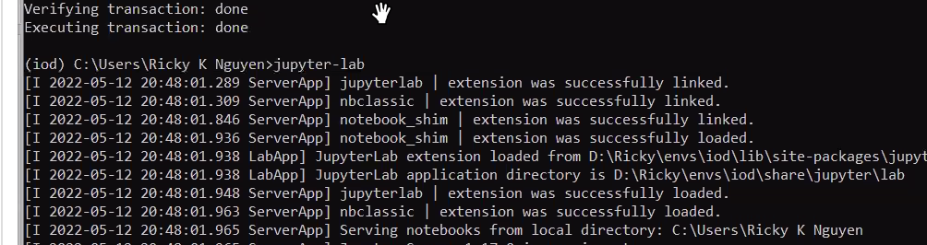

Slide 25
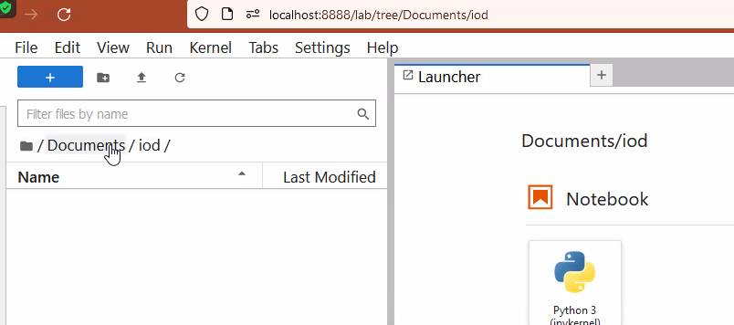

Slide 26
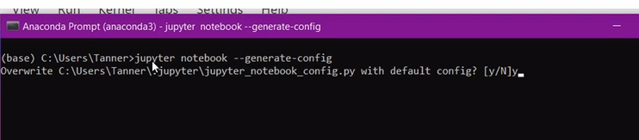

Slide 27
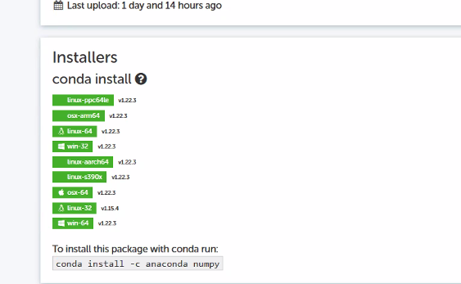
Always use conda to install , no pip
Conda will make sure there is no crash between libraries, will make sure these libraries are independents with each other

